Slide 1
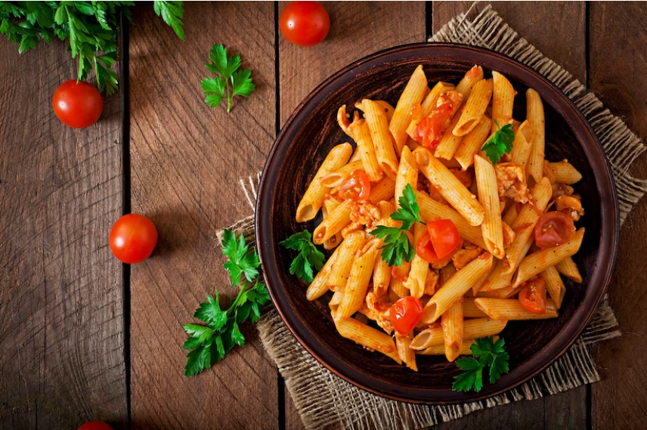


Slide 2
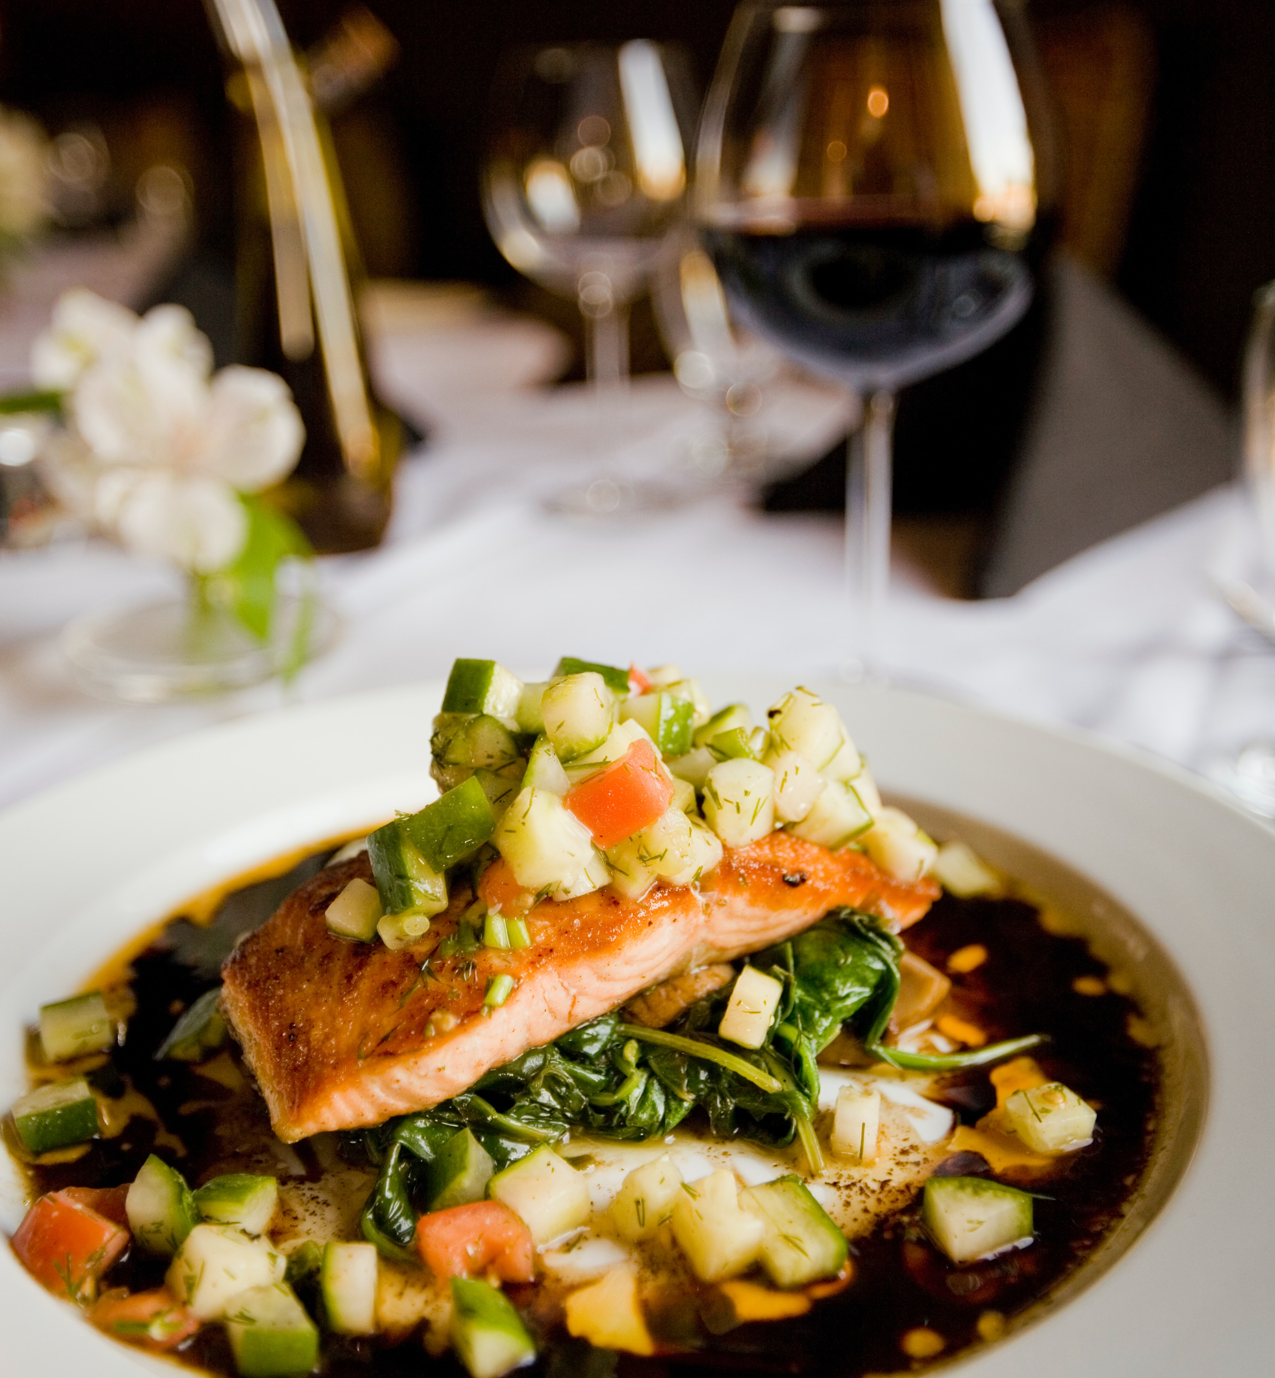
Agenda
Introduction
Modules
Purpose
Scope
Technology used
Flow diagram
WebPages template
Conclusion

Slide 3



Introduction
Delight Dine is to help restaurant administrator manage the restaurant business more efficiently.
Improving restaurant operations through technology

Slide 4
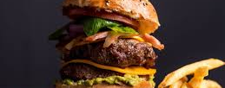
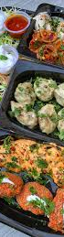
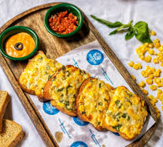
Modules
Admin
Chef
Manager

Slide 5
Purpose
Efficient Restaurant Management
Supporting Small Businesses
Contactless Ordering
Digital Menu Presentation

Slide 6
Scope
Enhancing the dining experience
Maintain the data of the restaurant

Slide 7




Technology Used

Slide 8

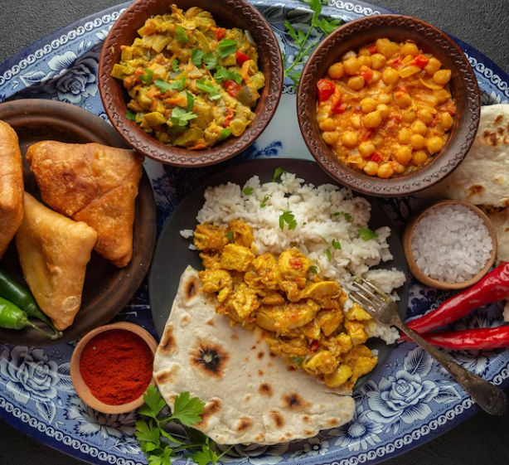
Frontend React Js Backend Java Spring Framework Database MySQL

Slide 9
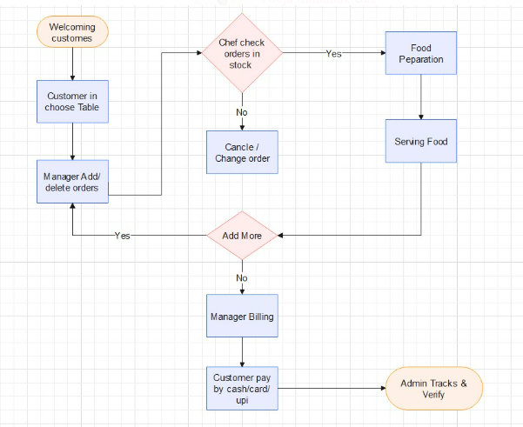
Flow diagram

Slide 10

Our Team
Janhavi Patil
Pooja Gadadare
Rajneesh Kumar
Vivek Kumar

Slide 11
Go to Website

Slide 12
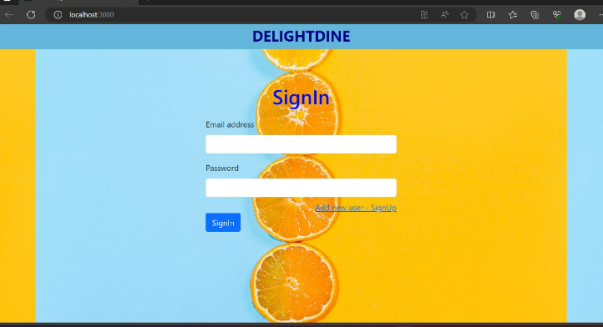
Webpages

Slide 13
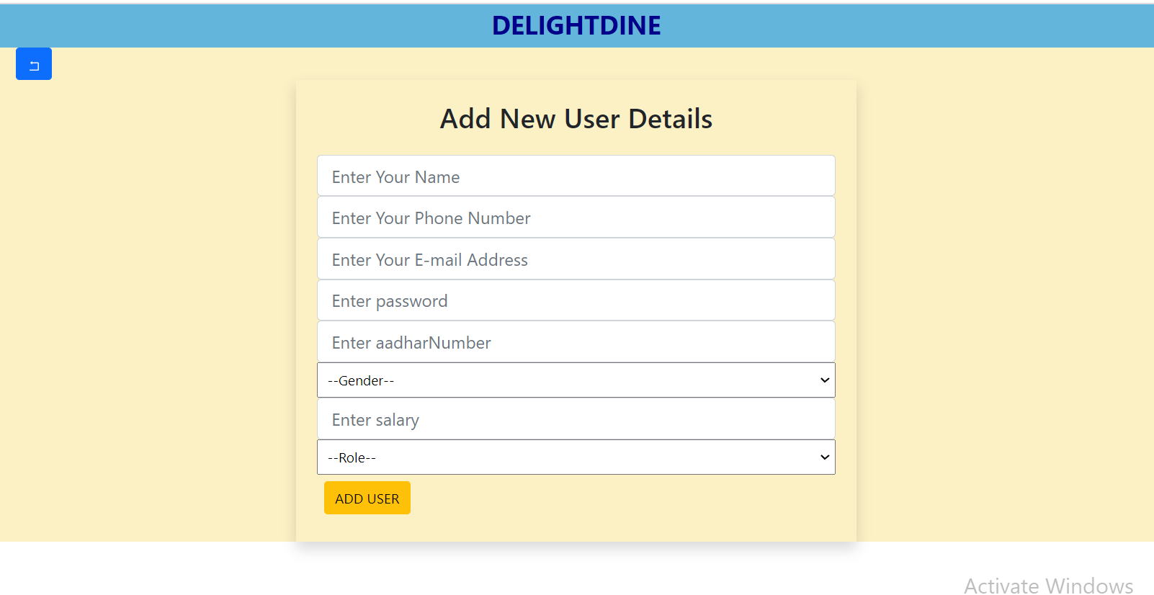
Webpages

Slide 14
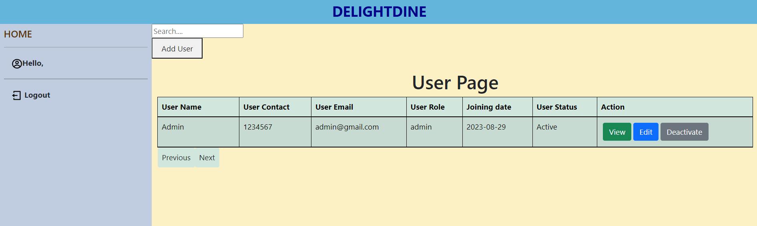
Webpages

Slide 15
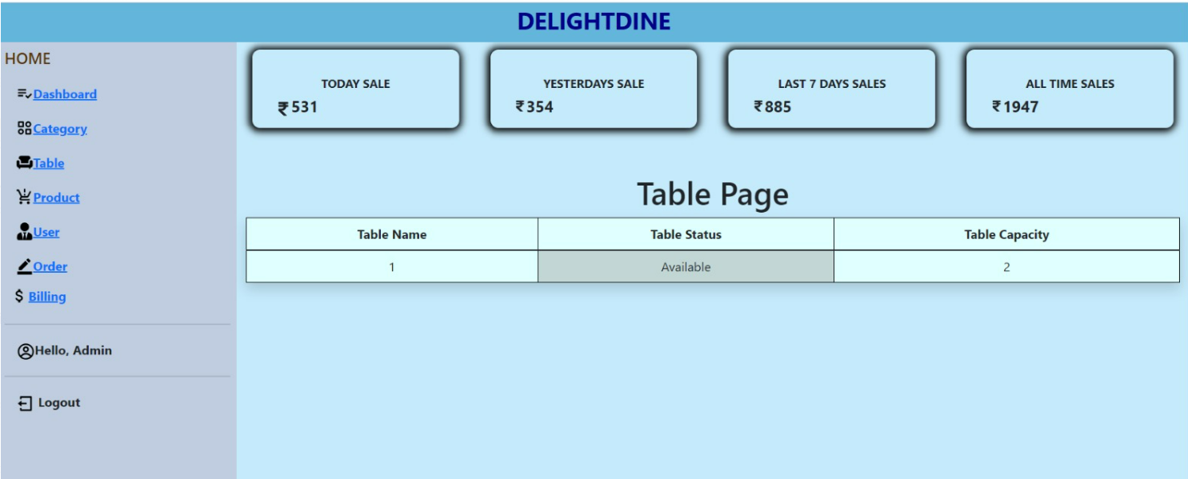
Webpages

Slide 16
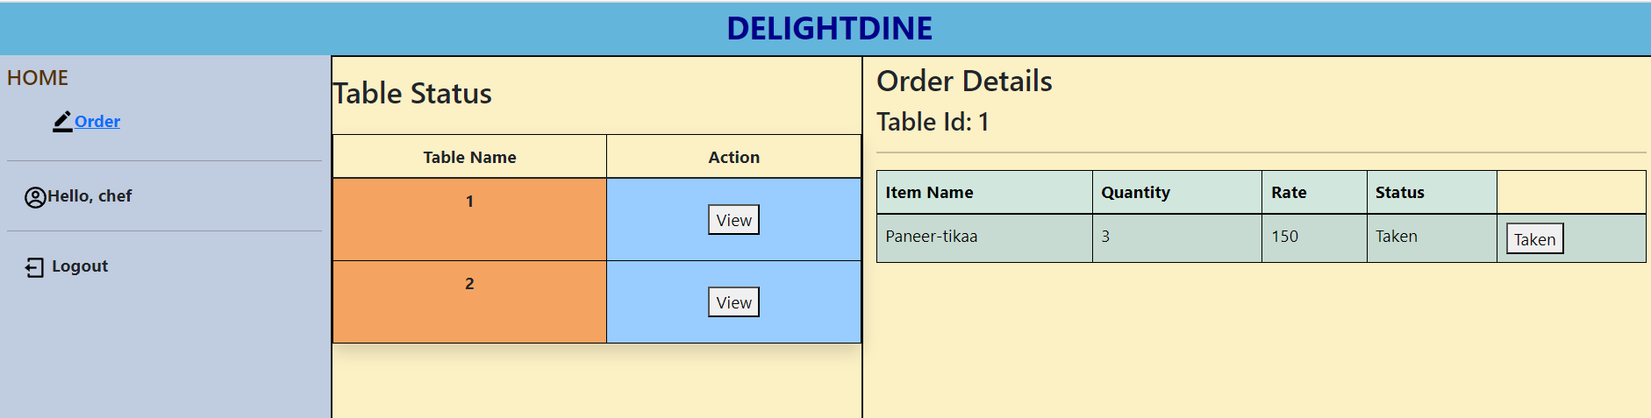
Webpages

Slide 17
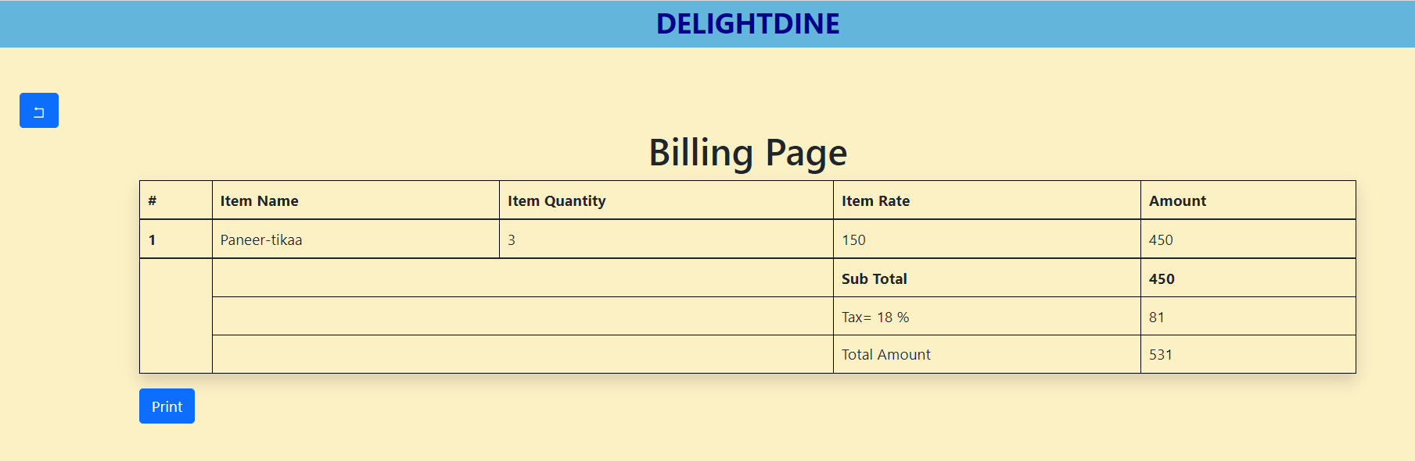
Webpages

Slide 18
Conclusion
Streamlined Operations
Data Analytics
Enhanced Reporting
Scalability

Slide 19
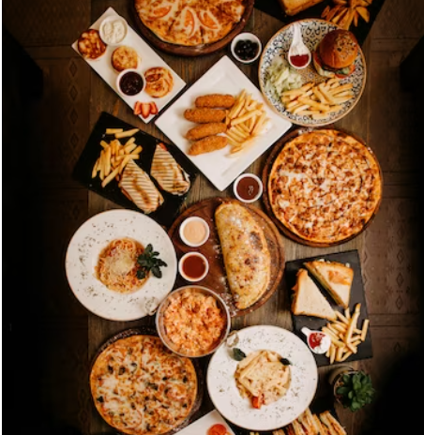
Thank You

